Slide 1

Time varying covariates in a Cox model
Steve Simon for
Notes:
Analyzing Repeated Measures Data Workshop: Module 5 The Linear Mixed Model
Copyright 2011 The Analysis Factor http://TheAnalysisFactor.com
1

Slide 2
Abstract
Lecture 7.
Time varying covariates allow you to account for non-proportional hazards and can model settings where patients switch from one therapy to another. You will code data for time-varying covariates, fit time-varying models, and interpret the results.

Slide 3
Testing the proportional hazards assumption
Several approaches
Patterns in Kaplan-Meier curves
Complementary log-log plot
Schoenfeld Residuals
Fit time varying covariates
Save this for another day

Slide 4
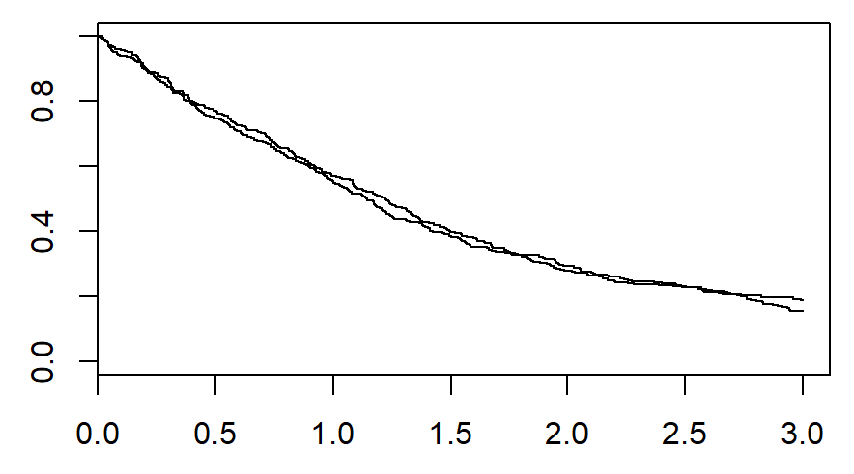
Patterns in the Kaplan-Meier curves

Slide 5
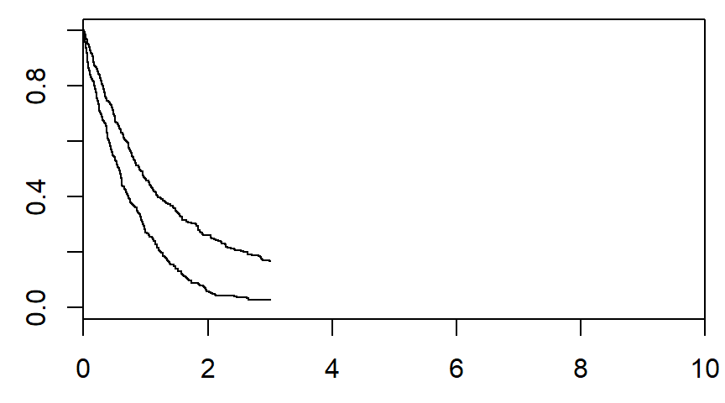
Patterns in the Kaplan-Meier curves

Slide 6
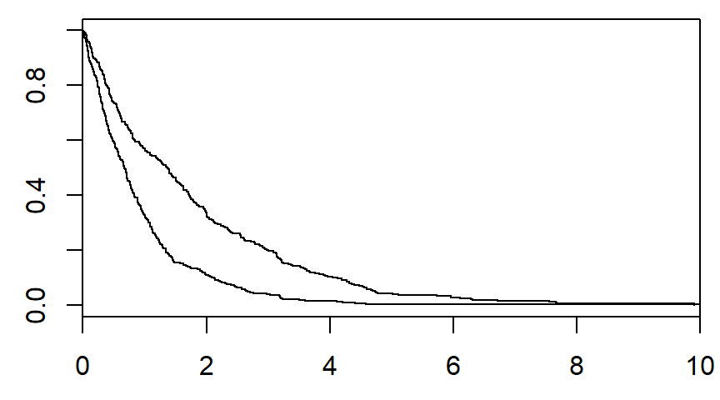
Patterns in the Kaplan-Meier curves

Slide 7
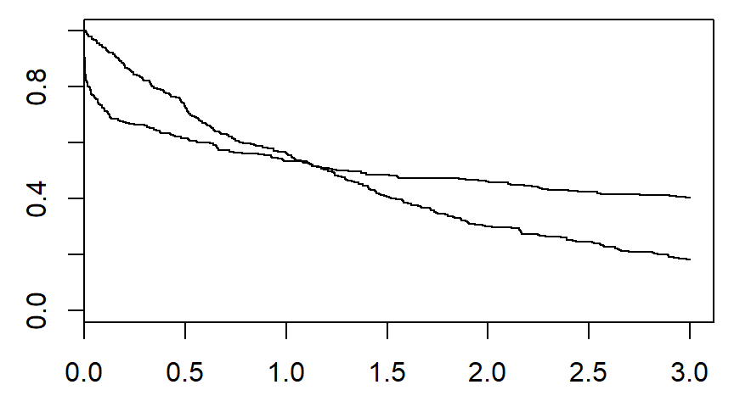
Patterns in the Kaplan-Meier curves

Slide 8
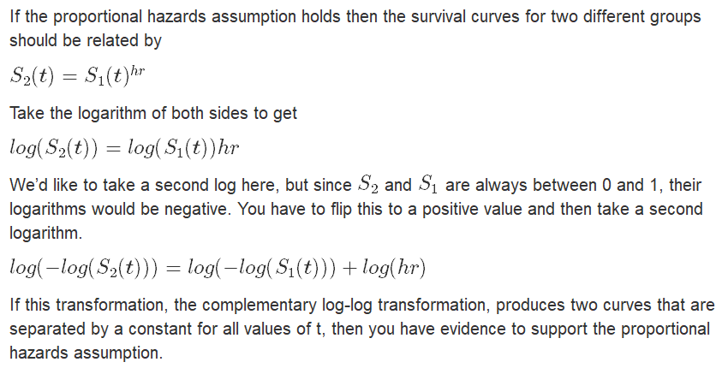
Complementary log-log

Slide 9
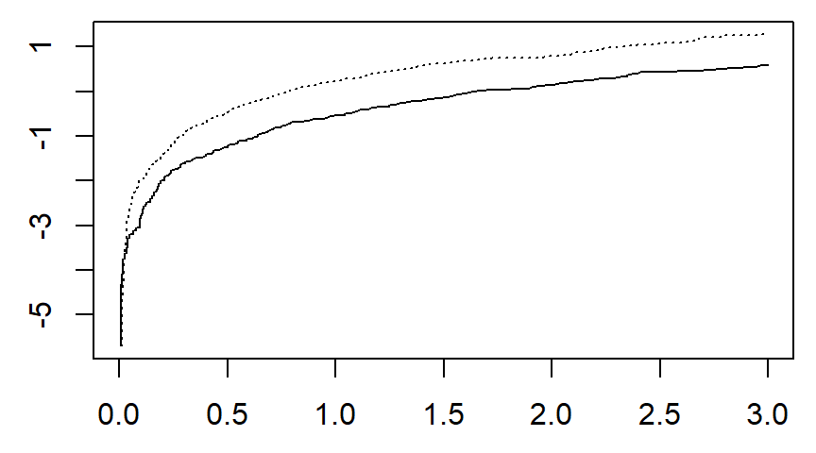
Complementary log-log

Slide 10
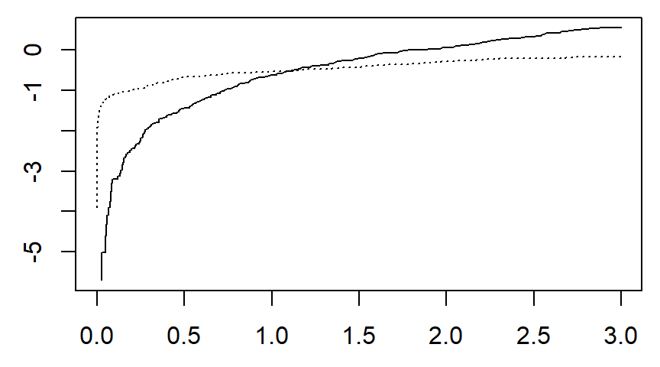
Complementary log-log

Slide 11
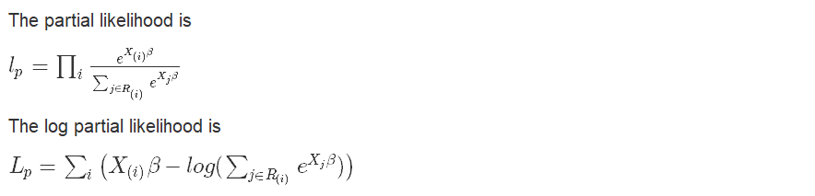
Review of likelihood

Slide 12
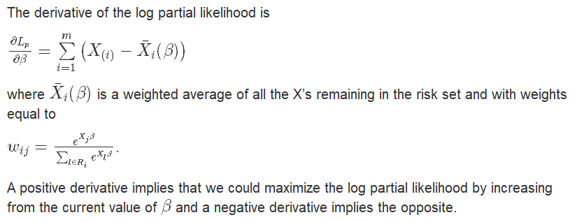
Review of likelihood

Slide 13
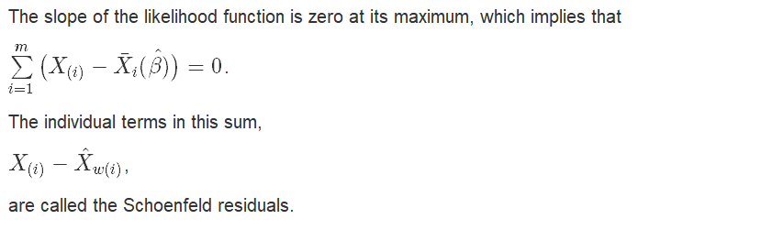
Schoenfeld residuals

Slide 14
Schoenfeld residuals
Interpretation
Normally, the Schoenfeld residuals are standardized.
A time trend is evidence of a violation of the proportional hazards assumption.
Consider this as evidence of an interaction between time and your independent variable.

Slide 15
Schoenfeld residuals
Interpretation
Regions of time where residuals are negative
the hazard ratio is a bit too large.
Regions of time where residuals are positive
the hazard ratio is a bit too small.

Slide 16
Conclusion
What have you learned today?
The

